Slide 1
IEO – week 8

Slide 2
This week
Internet Protocol
Internet Addressing
Subnet
Notes:
Applies to al electronic devices?

Slide 3
Layered Communication: TCP/IP Protocols Overview
Application Layer
HTTP
DNS
FTP
DHCP
DHCP
Telnet
SMTP
Transport Layer
TCP
UDP
Network Layer
IP
DataLink Layer
Ethernet
Wifi
Bluetooth
Physical Layer
Ethernet
Wifi
Bluetooth

Slide 4
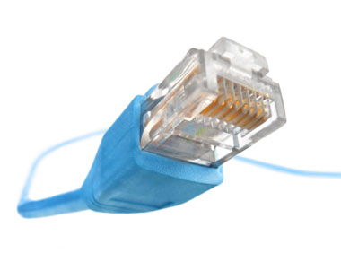
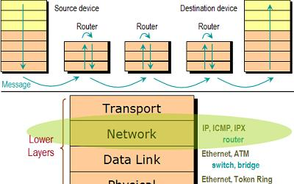
IP Protocol
Layer 3 (Network layer) Protocol
Connectionless Protocol
Unreliable
Best Effort Service
Delivers Datagrams
Responsible for Routing

Slide 5
IP Addressing
192.68.1.125
192
68
1
125
11000000
01000100
00000001
01111101
32 bits

Slide 6
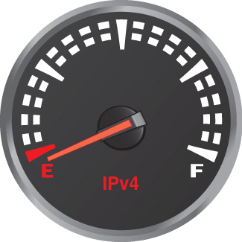
IP Addressing
IPv4 :
2³² = 4 294 967 296 addresses

Slide 7
IP Addressing
192.68.1.125
192
68
1
125
Network id
Host id

Slide 8
IP Classful Addressing
History :
Network ID was 8 bits
How many hosts could we then address ?
2²⁴-2
… but only 2⁸ (256) subnets

Slide 9
IP Classful Addressing
Later :
To accommodate more networks Classful Addressing was used
More flexibility in the number of networks to be used

Slide 10
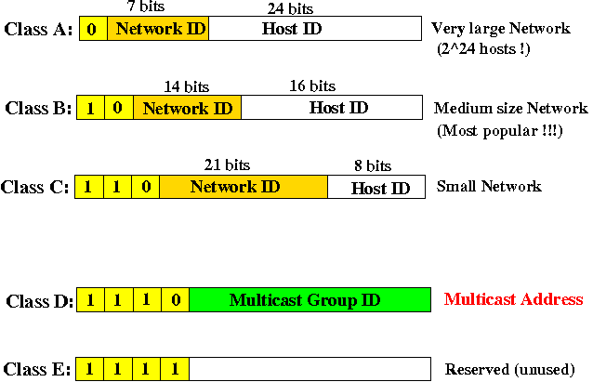
IP Classful Addressing

Slide 11
IP Addressing
Now :
To allow even more flexibility in IP addressing
IP Classless Addressing

Slide 12
IP CIDR (Classless Inter Domain Routing) Addressing
192.168.1.125/24
192
68
1
125
Network id
Host id
Subnet Mask :
11111111.11111111.11111111.00000000

Slide 13
IP Subnetting
192.68.1.125/255.255.255.0
192
68
1
125
Network id
Host id
Subnet Mask :
11111111.11111111.11111111.00000000
or
255.255.255.0

Slide 14
IP Subnetting
192.68.1.125/24
192
68
1
125
Network id
Host id
Network :
192.168.1.0
Hosts :
2^{n}-2 = 2⁸-2 = 254

Slide 15
IP Addressing
Host ID consisting of all 0s or all 1s are special, they can’t be used for assigning a host
Host id consisting of all 0s is used to assign the whole network, in our example it is : 192.168.1.0
Host id consisting of all 1s is used to assign broadcast address, in our example it is : 192.168.1.255

Slide 16
IP Addressing
Special Address Ranges :
10.0.0.0/8 (private networks)
192.168.0.0/16 (private networks)
172.16.0.0/12 (private networks)
169.254.0.0/16 (link-local addresses)
127.0.0.0/8 (loopback addresses)

Slide 17
ARP: Address Resolution Protocol
ARP does address resolution between an IP address and hardware MAC address within LAN network

Slide 18
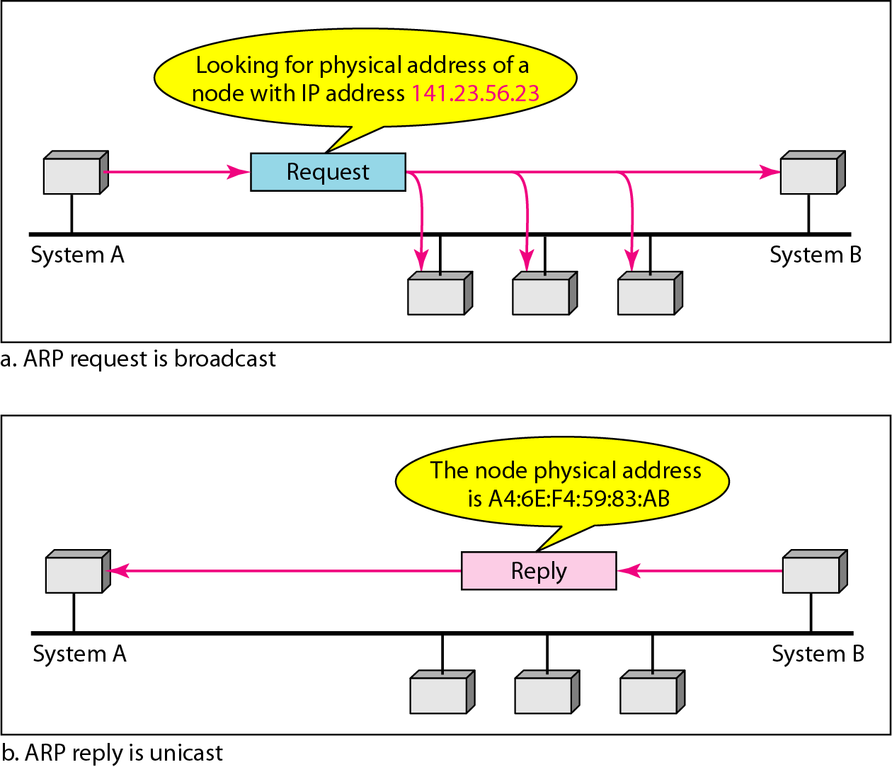
ARP Protocol

Slide 19

ARP Protocol

Slide 20
ICMP Protocol
The Internet Control Message Protocol is used by the network devices to send error messages indicating, for example, non-availability of a requested service.
The ICMP can also be used for the network diagnosis (the ping command).

Slide 21

ICMP : Ping and Traceroute

Slide 22

Several useful Linux networking commands
Configure network interfaces:
ifconfig command
Example:
ifconfig eth0 192.168.1.2 netmask 255.255.255.0
Configure eth0 interface with an IP address and subnet mask.
ifconfig -a
Show all network interfaces of this machine.

Slide 23
Several useful Linux networking commands
Configure network interfaces:
ip command
Example:
ip addr add 192.168.1.2/24 dev eth0
Configure eth0 interface with an IP address and subnet mask.
ip addr show
Show all network interfaces of this machine.

Slide 24
Several useful Linux networking commands
Manipulate the system arp cache:
arp command
Example:
arp
Show current ARP cache entries.
arp –d 192.168.1.1
Delete ARP cache entry for the IP address 192.168.1.1.

Slide 25
Several useful Linux networking commands
Network Diagnosis:
ping command
Example:
ping 192.168.1.1
Send ICMP Echo Request (ping) to 192.168.1.1 to see whether the node 192.168.1.1 is alive.

Slide 26
Several useful Linux networking commands
Print the route a packet follows to the destination
traceroute command
Example:
traceroute 192.168.1.1
Shows the IP addresses of the hops leading to the IP address 192.168.1.1

Slide 27

Questions?

